Slide 1

TIME SERIES ANALYSIS PROJECT PRESENTATION
STYLE ANALYSIS OF WARREN BUFFET USING THE FAMA-FRENCH MODEL

Slide 2
DATASET DESCRIPTION
Fama French is based on factor models, where investors pick stocks and rebalance portfolio based on some intrinsic qualities about the company.
If you want to make a burger, either you can specify the ingredients that you want to use or you can specify the nutrients. Drawing analogy to the stock market, either you can pick technology stocks, utilities companies or other kind of sector-related stocks. This corresponds to specifying ingredients for the burger
But if you go by specifying ingredients like plant-based protein burger, you can go for intrinsic qualities like ESG investing, female CEO etc.

Slide 3
DATASET VARIABLES
The common factor models that we generally use are
SMB (Small Minus Big) is the average return on the nine small stock portfolios minus the average return on the nine big stock portfolios
HML (High Minus Low) is the average return on the two value portfolios minus the average return on the two growth portfolios,
RMW (Robust Minus Weak) is the average return on the two robust operating profitability portfolios minus the average return on the two weak operating profitability portfolios,
CMA (Conservative Minus Aggressive) is the average return on the two conservative investment portfolios minus the average return on the two aggressive investment portfolios,
Mkt (Market Return): Return for a broad market index like S&P500
Rf is the risk-free rate like treasury bill rate.

Slide 4
Prompt to Midjourney V for Warren Buffet
Warren Buffet showing off his money and mocking other investors being the richest investor of all time.

Slide 5

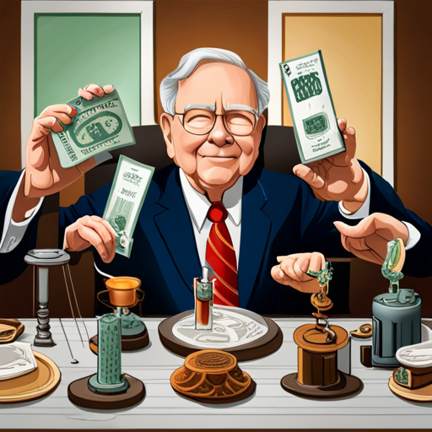





Slide 6
HYPOTHESIS
We took the data from 13F filling of Warren Buffet and computed his returns for the period 2000-2018. Also, we took the FAMA-FRENCH 5 factor data from here
We all know about WARREN BUFFET and his stress on investing in value and conservative stocks instead of growth stocks. Value stocks that have a high book to market ratio, like the utility's companies. Growth stocks are Google and Facebook of the world. They have lower book to market ratio; they have huge growth potential.
So, we have the response column as Berkshire Hathaway portfolio returns from 2000 to 2018. So, we will be analyzing the fact whether Warren Buffet has more exposure to Value investing or not. To showcase that, we need to have more weight for the regression coefficients for the HML and RMW column. This will reinforce that Warren Buffet had more exposure to value companies, rather than growth or small companies. This is called as Style analysis in the literature.

Slide 7
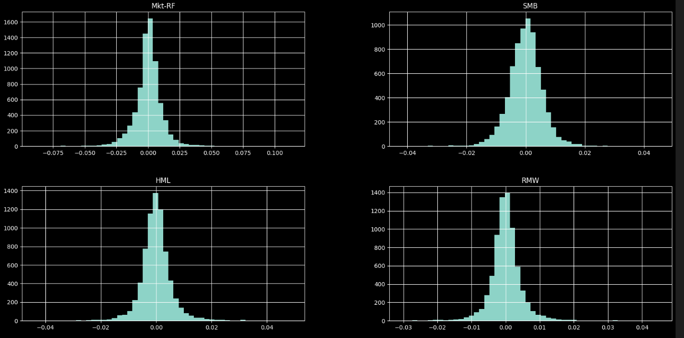
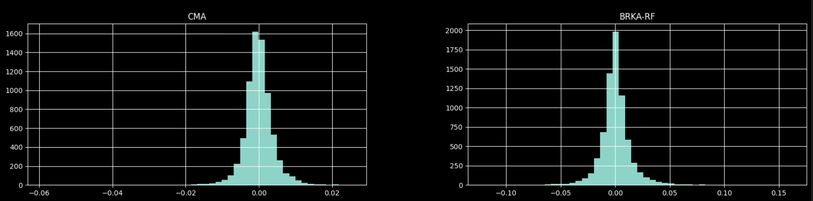
NORMALITY OF DATA

Slide 8
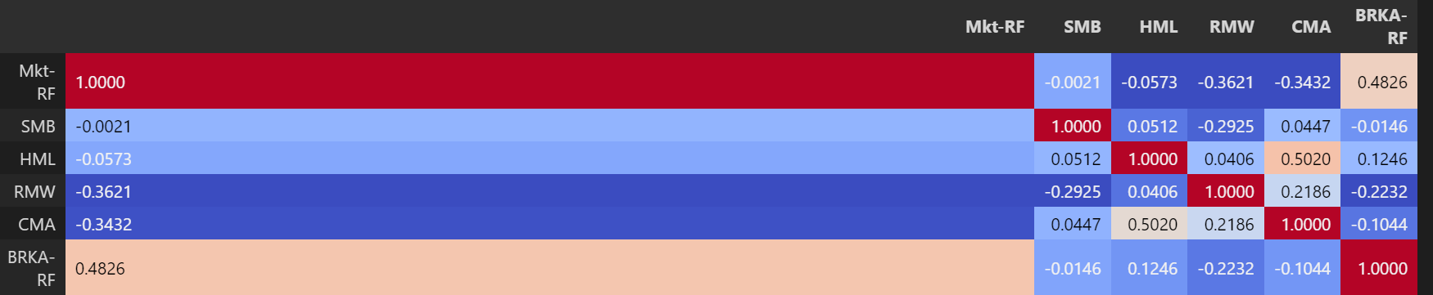
CORRELATION PLOT
WATCH THE LAST ROW

Slide 9
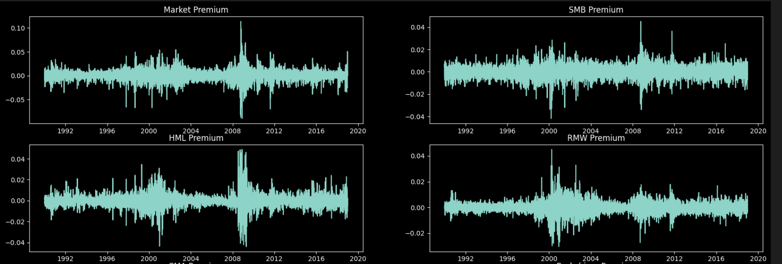
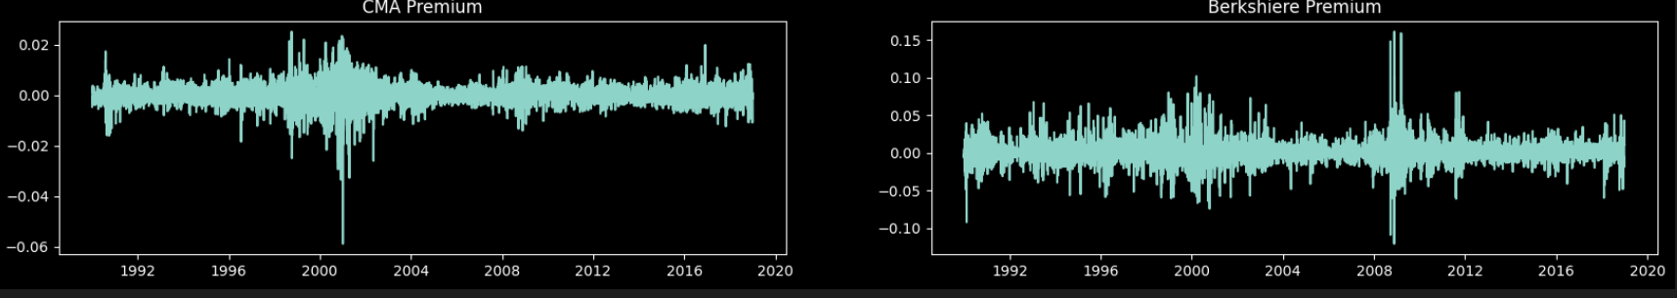
TIME SERIES PLOT

Slide 10

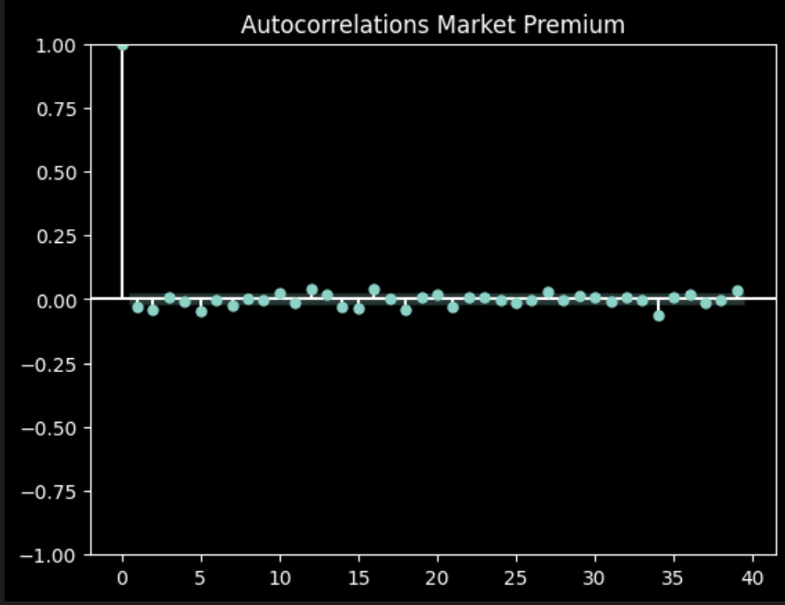
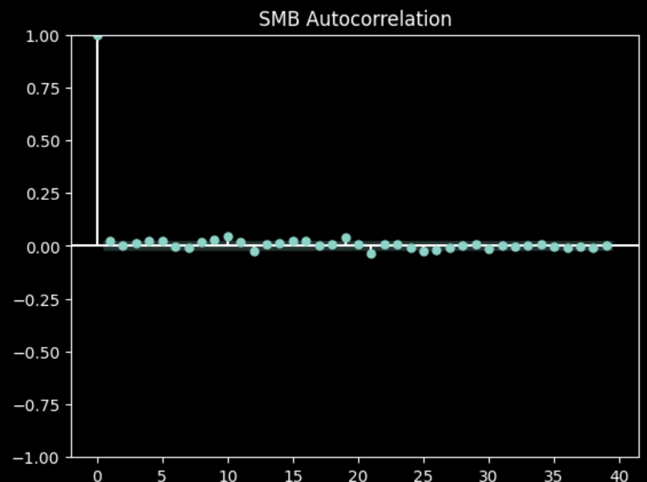
AUTOCORRELATIONS PLOTS

Slide 11
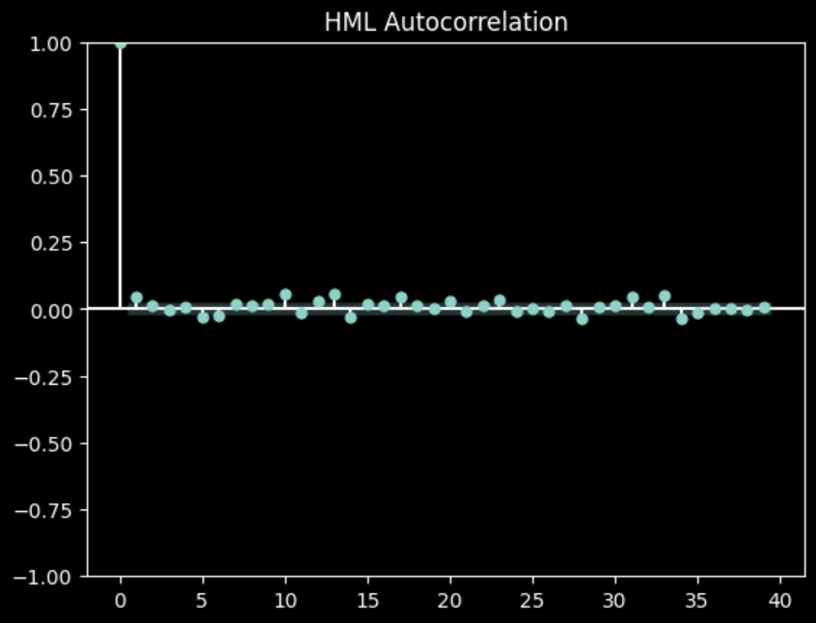
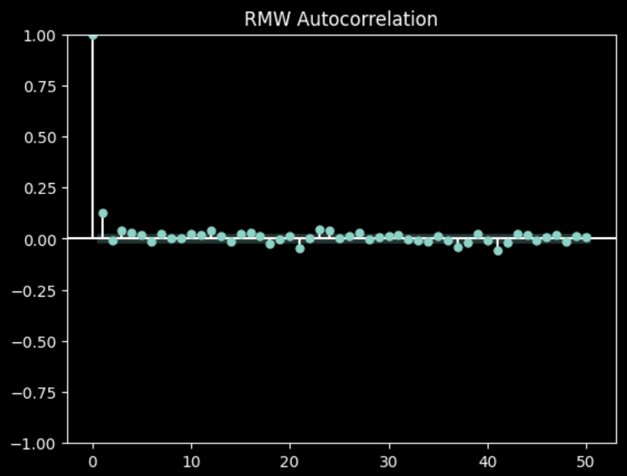

Slide 12
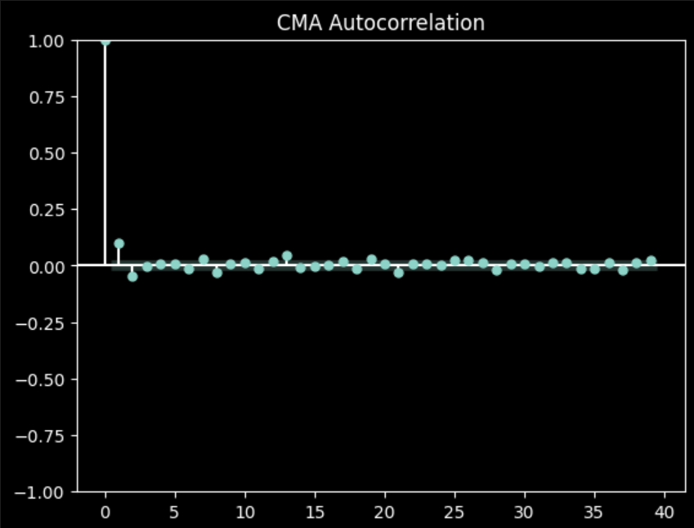
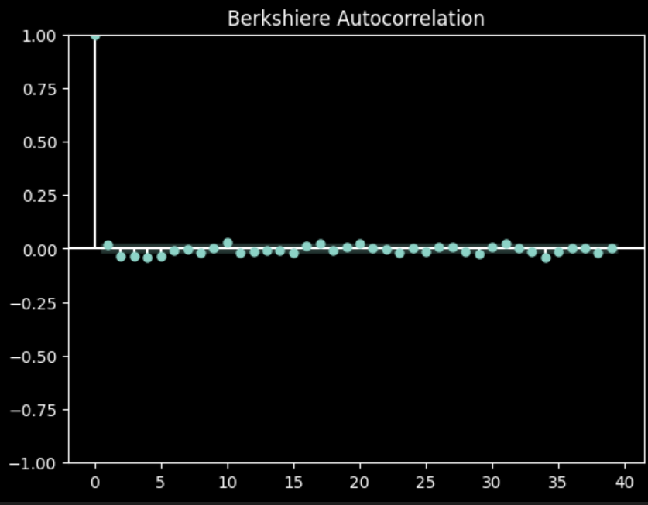

Slide 13
SUMMARY OF AUTO-CORRELATIONS
From the ACF plots, we can see that there is almost no correlations with the lagged input. For RMW and CMA, we get some amount of correlations, but they are minimal
This stands well with stock market returns, as they are random walk, so auto-correlations are negligent.

Slide 14
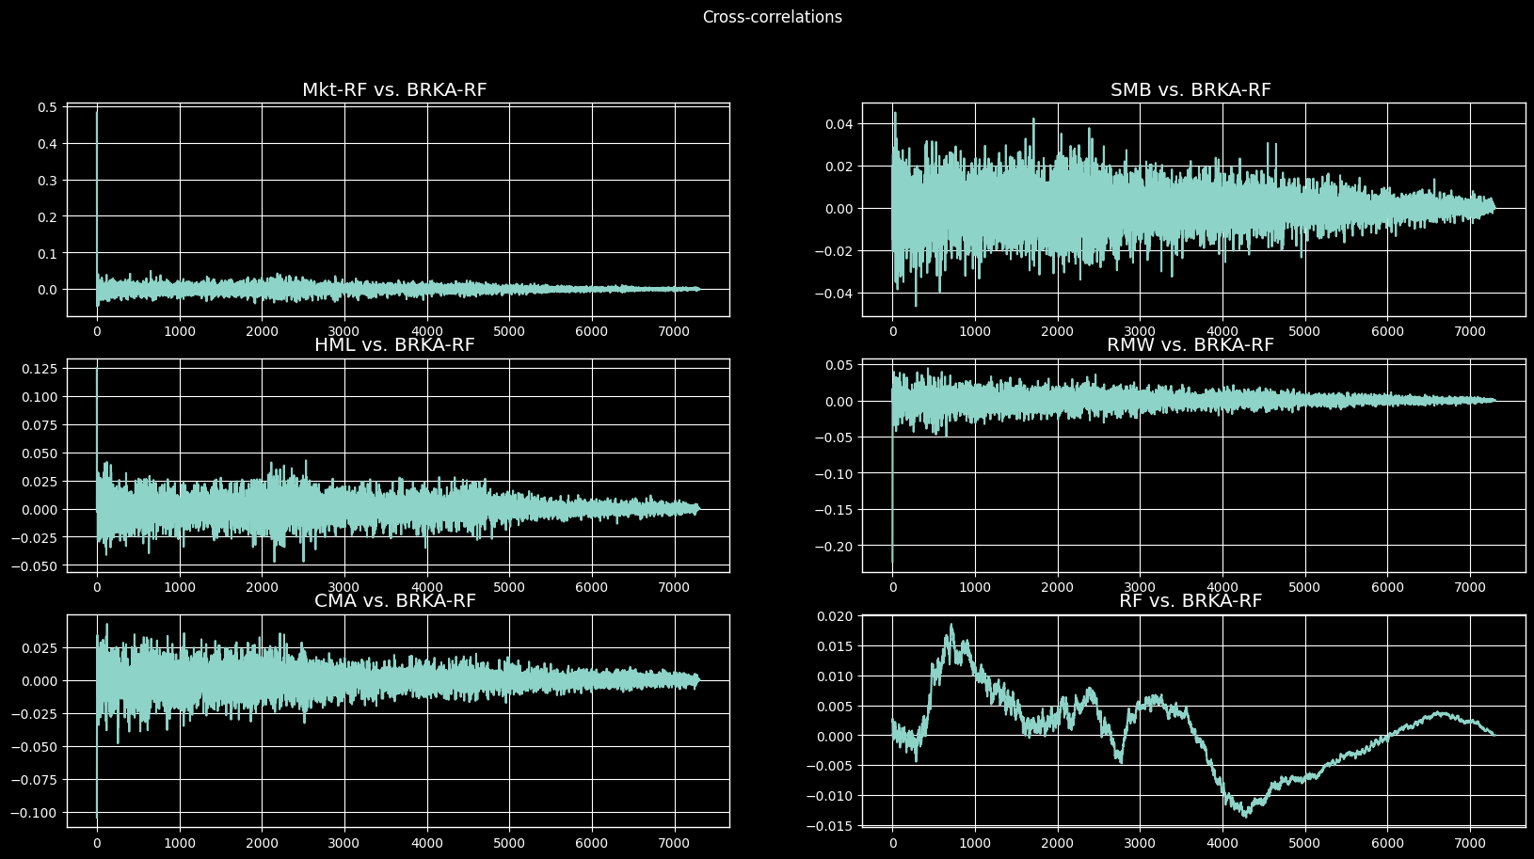
CROSS-CORRELATIONS

Slide 15
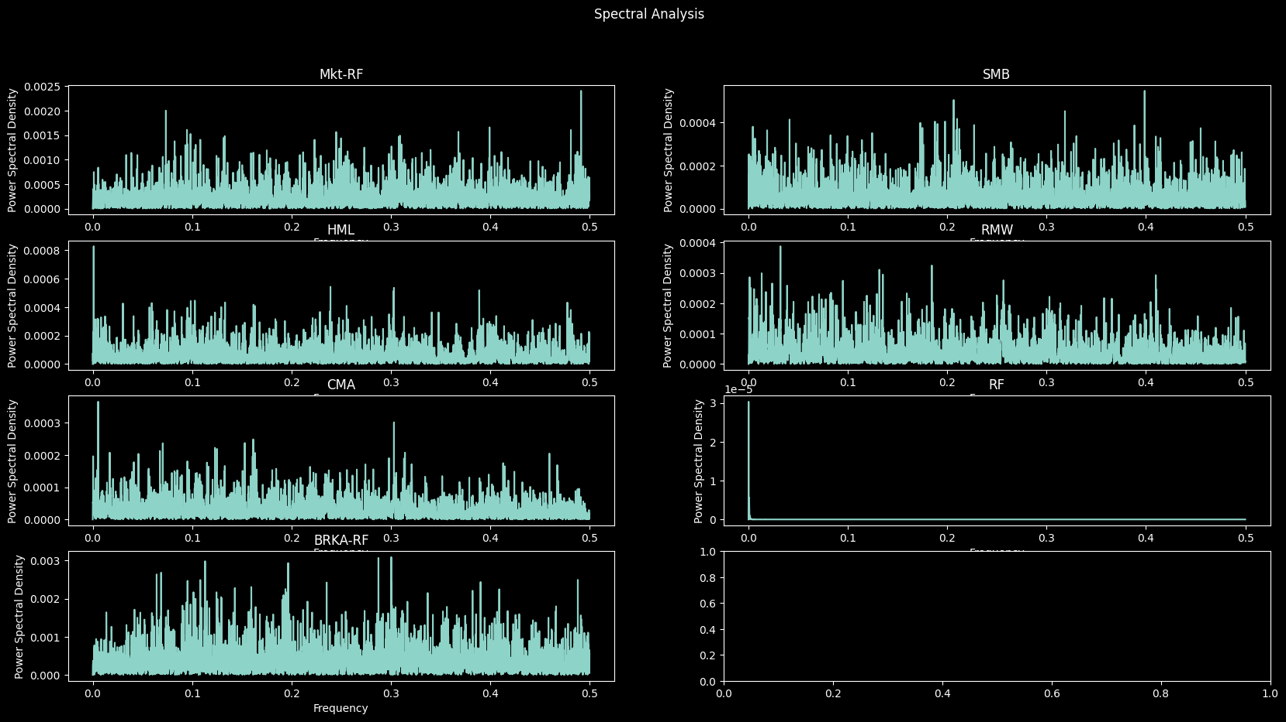
SPECTRAL ANALYSIS

Slide 16
MODEL SELECTION
https://wandb.ai/rf_project/Time-Series-Project/sweeps/v82b5hzv?workspace=user-athe_kunal
https://wandb.ai/rf_project/Time-Series-Project/sweeps/2fjvn2ms?workspace=user-athe_kunal
Link 3 here
The columns are
Predictors: 'Mkt-RF', 'SMB', 'HML', 'RMW', 'CMA’,
Response: 'BRKA-RF'

Slide 17
SUMMARY FROM MODEL SELECTION
Higher difference order gave higher AIC and BIC, so for model comparison, lower difference equation terms are better
Higher AR terms are good had a better fit as the prices in stock market drive prices. Hence the momentum strategy comes into play here and this drives the prices
From model comparison, we got (1,0,0) (0,0,0)0 and (5,3,4) (0,0,0)0 and (3,0,4) (0,0,0)63

Slide 18
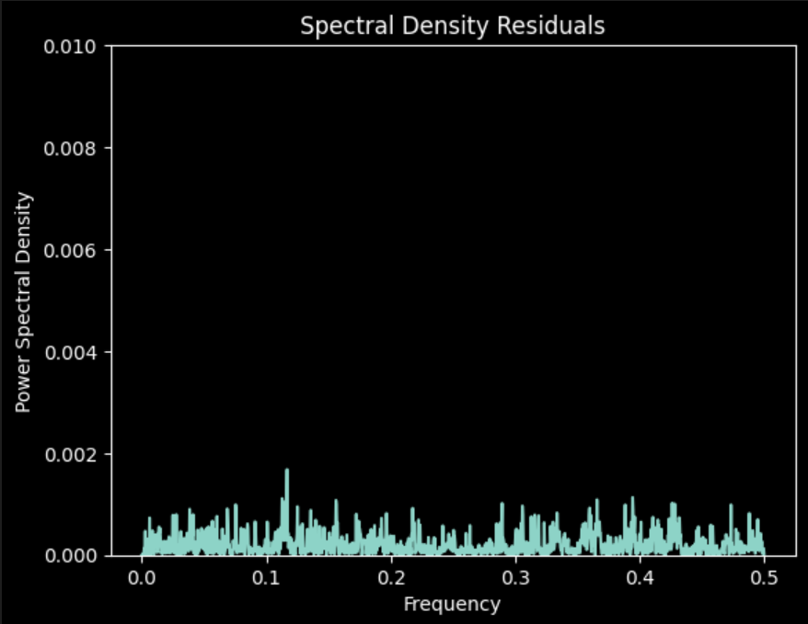
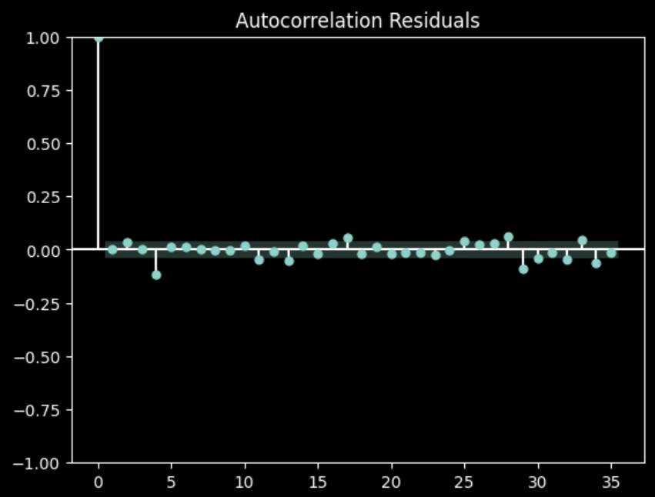
AUTO-CORRELATION AND SPECTOGRAM OF RESIDUALS (1,0,0)
ARMA(1,0) x SARMA(0)

Slide 19
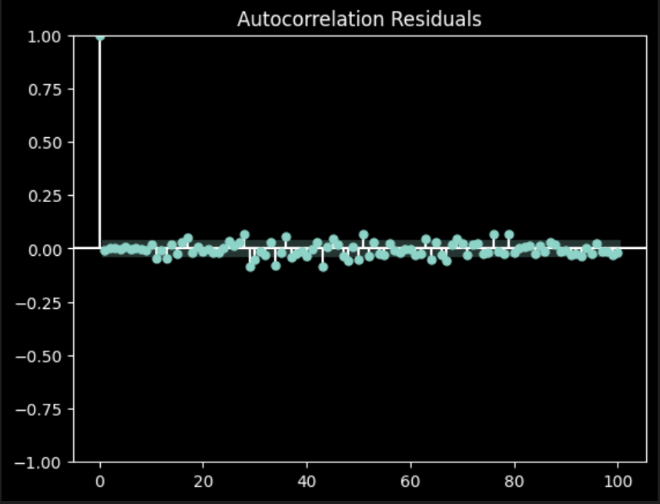
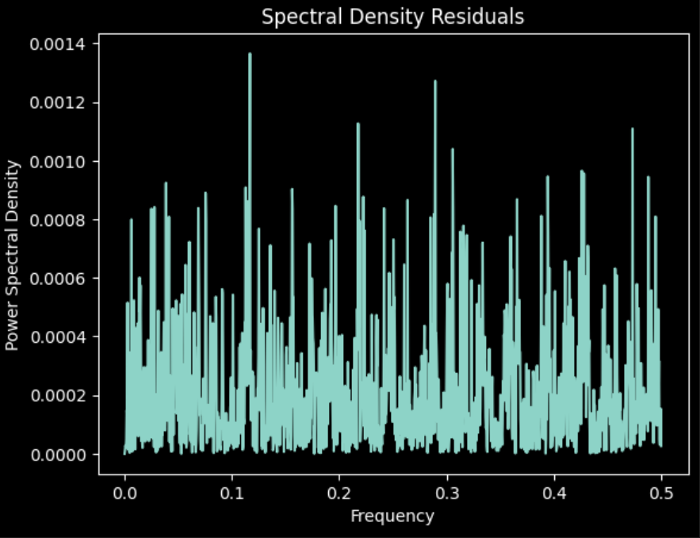
AUTO-CORRELATION AND SPECTOGRAM OF RESIDUALS (3,0,4)(0,0,0,63)
ARMA(3,4) x SARMA(0,0)(63)

Slide 20
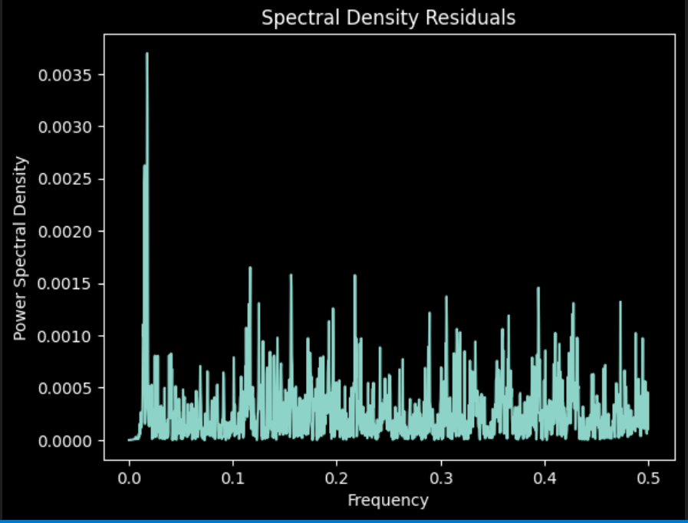
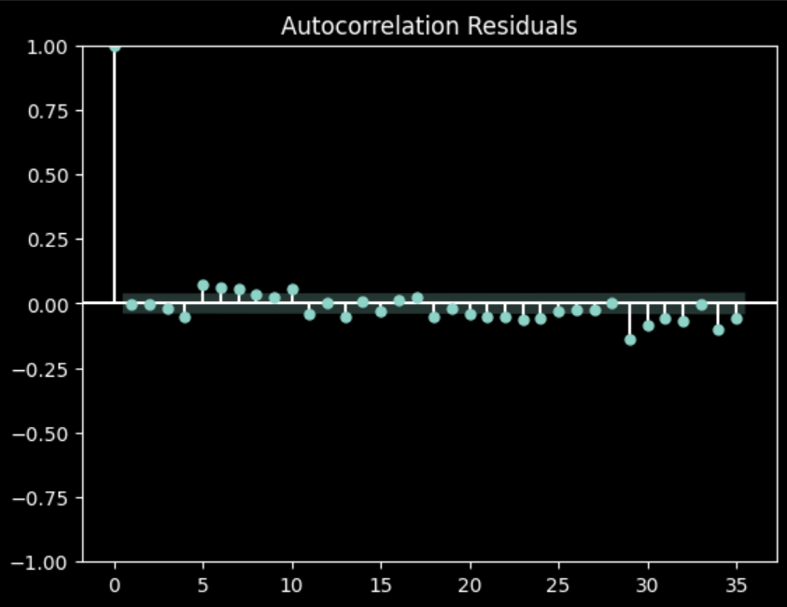
AUTO-CORRELATION AND SPECTOGRAM OF RESIDUALS (5,3,4) ARMA(5,3,4) x SARMA(0)

Slide 21
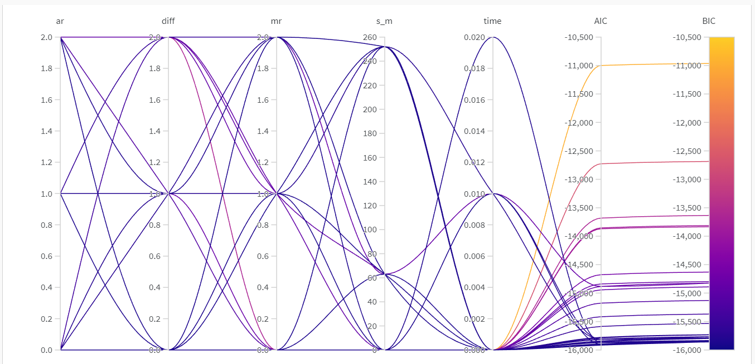
WANDB RUN

Slide 22
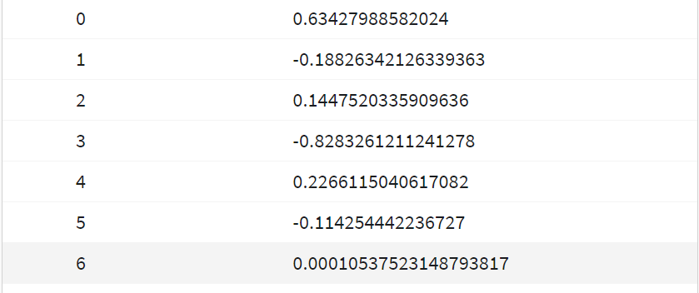
The Coefficients of the Model are (NOTICE THAT WEIGHTS OF HML, MARKET AND CMW ARE THE HIGHEST)
MARKET RETURN
SMB
HML
RMW
CMW
AR_1
INTERCEPT

Slide 23
CONCLUSION
So the Model (1,0,0), with AR(1) process, was the best model from extensive model search.
And for our hypothesis, if we check the coefficients for the model, we will see that the coefficients for HML and CMA are the highest after the market portfolio
This signifies that the returns of Warren Buffet portfolio is more aligned with value and conservative investing. We have statistically significant results to conclude the style of Warren Buffet.

